Slide 1


PYTHON
Lecture 41

Slide 2

Today’s Agenda
Introduction To Object Oriented Programming-III
Adding Class Variables
Different Ways To Create A Class Variable
Different Ways To Access A Class Variable
Obtaining Details Of Class Variables
Deleting Class Variables

Slide 3
Class Variables
Class variables are those variables which are defined within the class body outside any method
They are also called as static variables , although there is no static keyword used with them

Slide 4
Class Variables
The are shared by all instances of the class and have the same value for each instance of the class.
They have a single copy maintained at the class level

Slide 5
What Is Class Level ?
The term class level means inside the class object.
In Python , for every class one special object is created called as class object
Don’t think it is the same object which we create. No it is not that!
Rather , for every class , Python itself creates an object called as class object and inside this object all the class / static variables live

Slide 6
When Should We Use Class Variable ?
Whenever we don’t want to create a separate copy of the variable for each object , then we can declare it as a class variable.
For example :
The variable pi in a class called Circle can be declared as a class level variable since all Circle objects will have the same value for pi
Another example could be a variable called max_marks in a class called Student . It should also be declared at the class level because each Student will have same max_marks

Slide 7
Using Class Variable
We can use a class variable at 6 places in Python:
Inside the class body but outside any method
Inside the constructor using the name of the class
Inside instance method using name of the class
Inside classmethod using name of the class or using the special reference cls
Inside staticmethod using the name of the class
From outside the class using name of the class

Slide 8
Declaring Inside Class Body
To declare a class variable inside class body but outside any method body , we simply declare it below the class header
Syntax:
class <class_name>:
<var_name>=<value>
def __init__(self):
// object specific code
To access the class level variables we use class name before them with dot operator
This is called a class variable

Slide 9
How To Access/Modify Class Variables?
We must clearly understand the difference between accessing and modifying .
Accessing means we are just reading the value of the variable
Modifying means we are changing it’s value

Slide 10
How To Access Class Variables?
The class variables can be accessed in 4 ways:
Using name of the class anywhere in the program
Using self inside any instance method
Using object reference outside the class
Using special reference cls inside classmethod

Slide 11
How To Modify Class Variables?
The class variables can be modified in 3 ways:
Using name of the class anywhere inside the methods of the class
Using special reference cls inside classmethod
Using name of the class outside the class body
Special Note:We must never modify a class variable using self or object reference , because it will not modify the class variable , rather will create a new instance variable by the same name

Slide 12
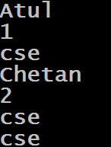
Example
The variable stream is class variable
class CompStudent:
stream = 'cse'
def __init__(self,name,roll):
self.name = name
self.roll = roll
obj1 = CompStudent('Atul',1)
obj2 = CompStudent('Chetan', 2)
print(obj1.name)
print(obj1.roll)
print(obj1.stream)
print(obj2.name)
print(obj2.roll) Output:
print(obj2.stream)
print(CompStudent.stream)
Everytime we will access the class variable stream from any object , the value will remain same

Slide 13
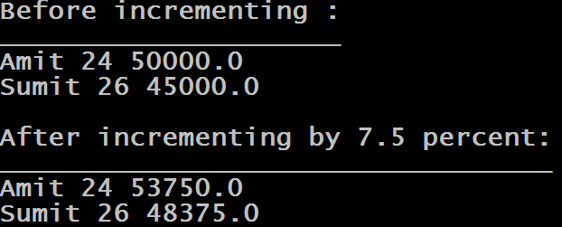
Exercise
Write a program to create a class called Emp , having an instance members called name , age and sal . Also declare a class variable called raise_amount to store the increment percentage of sal and set it to 7.5 .
Now provide following methods in your class
__init___() : This method should initialize instance members with the parameter passed
increase_sal(): This method should calculate the increment in sal and add it to the instance member sal
display(): This method should display name , age and sal of the employee
Finally , in the main script , create 2 Emp objects , initialize them and increase their salary . Finally display the data
Output:

Slide 14
Solution
class Emp:
raise_amount=7.5
def __init__(self,name,age,sal):
self.name=name
self.age=age
self.sal=sal
def increase_sal(self):
self.sal=self.sal+(self.sal*Emp.raise_amount/100)
def display(self):
print(self.name,self.age,self.sal)
e1=Emp("Amit",24,50000.0)
e2=Emp("Sumit",26,45000.0)
print("Before incrementing :")
print("_____________________");
e1.display()
e2.display()
e1.increase_sal()
e2.increase_sal()
print()
print("After incrementing by",Emp.raise_amount,"percent:")
print("__________________________________");
e1.display()
e2.display()

Slide 15
Declaring Class Variable Inside Constructor
We can declare a class variable inside the constructor also by prefixing the variable name with the name of the class and dot operator
Syntax:
class <class_name>:
def __init__(self):
<class name>.<var_name>=<value>
self.<var_name>=<value>
.
.
.
This is called a class variable

Slide 16
Example
class CompStudent:
def __init__(self,name,roll):
CompStudent.stream='cse'
self.name = name
self.roll = roll
obj1 = CompStudent('Atul',1)
obj2 = CompStudent('Chetan', 2)
print(obj1.name)
print(obj1.roll)
print(obj1.stream)
print(obj2.name)
print(obj2.roll) Output:
print(obj2.stream)
print(CompStudent.stream)
We have shifted the var decl from class body to constructor body , but still it will be treated as class variable because we have prefixed it with classnname

Slide 17
Declaring Class Variable Inside Instance Method
We can declare a class variable inside an instance method also also by prefixing the variable name with the name of the class and dot operator
Syntax:
class <class_name>:
def <method_name>(self):
<class name>.<var_name>=<value>
self.<var_name>=<value>
.
.
.
This is called a class variable

Slide 18
Example
class Circle:
def __init__(self,radius):
self.radius=radius
def cal_area(self):
Circle.pi=3.14
self.area=Circle.pi * self.radius ** 2
c1=Circle(10)
c2=Circle(20)
c1.cal_area()
print("radius=",c1.radius,"area=",c1.area,"pi=",Circle.pi)
c2.cal_area()
print("radius=",c2.radius,"area=",c2.area,"pi=",Circle.pi)
Output:
We have shifted the var decl from class body to method body , but still it will be treated as class variable because we have prefixed it with classnname

Slide 19
Obtaining Details Of Class Variables
As we know , class variables are owned by a class itself (i.e., by its definition), so to store their details a class also uses a dictionary called __dict__
Thus we can see that Python has 2 dictionaries called __dict__ .
One is <class_name>.__dict__ and the other is <object_ref>.__dict__

Slide 20
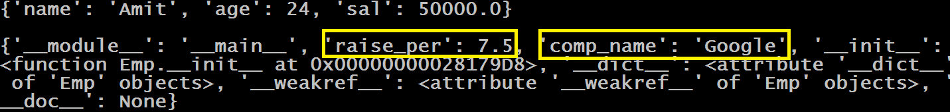
Guess The Output ?
class Emp:
raise_per=7.5
comp_name="Google"
def __init__(self):
self.name="Amit"
self.age=24
self.sal=50000.0
e1=Emp()
print(e1.__dict__)
print()
print(Emp.__dict__)
Output:

Slide 21
How many class variables will be created by this code?
Why the code is showing only 2 class variables even though we have 4 ?
This is because the class variable k will only be created when f1() gets called . Similarly the variable j will be created when we will create any object of the class . But since we didn’t create any object nor we have called the method f1( ) so only 2 class variables are there called i and m
class Sample:
i=10
def __init__(self):
Sample.j=20
def f1(self):
Sample.k=30
Sample.m=40
print(Sample.__dict__)
Output:

Slide 22
How many class variables will be created by this code?
class Sample:
i=10
def __init__(self):
Sample.j=20
def f1(self):
Sample.k=30
Sample.m=40
s1=Sample()
print(Sample.__dict__)
Output:
Three class variables will be created by the code called i,j and m

Slide 23
How many class variables will be created by this code?
Still only three class variables will be created by the code called i,j and m because class variables are not created per instance basis rather there is only 1 copy shared by all the objects
class Sample:
i=10
def __init__(self):
Sample.j=20
def f1(self):
Sample.k=30
Sample.m=40
s1=Sample()
S2=Sample()
print(Sample.__dict__)
Output:

Slide 24
How many class variables will be created by this code?
class Sample:
i=10
def __init__(self):
Sample.j=20
def f1(self):
Sample.k=30
Sample.m=40
s1=Sample()
s2=Sample()
s1.f1()
s2.f1()
print(Sample.__dict__)
Output:

Slide 25
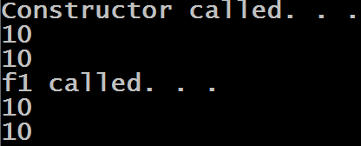
Guess The Output ?
class Sample:
i=10
def __init__(self):
print("Constructor called. . .")
print(Sample.i)
print(self.i)
def f1(self):
print("f1 called. . .")
print(Sample.i)
print(self.i)
s1=Sample()
s1.f1()
Output:

Slide 26
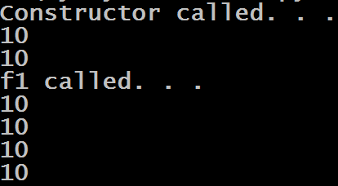
Guess The Output ?
class Sample:
i=10
def __init__(self):
print("Constructor called. . .")
print(Sample.i)
print(self.i)
def f1(self):
print("f1 called. . .")
print(Sample.i)
print(self.i)
Output:
s1=Sample()
s1.f1()
print(Sample.i)
print(s1.i)

Slide 27
Guess The Output ?
As mentioned previously , if we use self or object reference to modify a class variable , then Python does not modify the class variable . Rather it creates a new instance variable inside the object’s memory area by the same name.
So in our case 2 variables by the name i are created . One as class variable and other as instance variable
class Sample:
i=10
def __init__(self):
self.i=20
s1=Sample()
print(Sample.i)
Output:

Slide 28

Guess The Output ?
class Sample:
i=10
def __init__(self):
self.i=20
s1=Sample()
print(Sample.i)
print(s1.i)
Output:

Slide 29

Guess The Output ?
class Sample:
i=10
def __init__(self):
Sample.i=20
s1=Sample()
print(Sample.i)
print(s1.i)
Output:

Slide 30

Guess The Output ?
class Sample:
i=10
def __init__(self):
Sample.i=20
s1=Sample()
s1.i=30
print(Sample.i)
print(s1.i)
Output:

Slide 31

Guess The Output ?
class Sample:
i=10
def __init__(self):
Sample.i=20
s1=Sample()
Sample.i=30
print(Sample.i)
print(s1.i)
Output:

Slide 32

Guess The Output ?
class Sample:
i=10
def __init__(self):
self.j=20
s1=Sample()
s2=Sample()
s1.i=100
s1.j=200
print(s1.i,s1.j)
print(s2.i,s2.j)
Output:

Slide 33
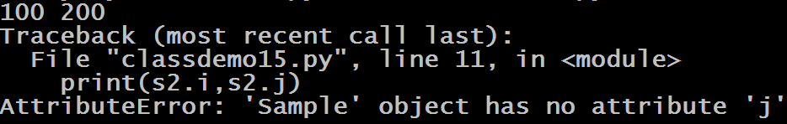
Guess The Output ?
class Sample:
i=10
def f1(self):
self.j=20
s1=Sample()
s2=Sample()
s1.i=100
s1.j=200
print(s1.i,s1.j)
print(s2.i,s2.j)
Output:

Slide 34

Guess The Output ?
class Sample:
i=10
def __init__(self):
self.j=20
s1=Sample()
s2=Sample()
Sample.i=100
s1.j=200
print(s1.i,s1.j)
print(s2.i,s2.j)
Output:

Slide 35
Deleting Class Variables
We can delete/remove instance variables in 2 ways
Using del classname .<var_name> from anywhere in the program
Using del cls.<var_name> from classmethod
Special Note: We cannot delete a class variable using object reference or self , otherwise Python will throw AttributeError exception

Slide 36
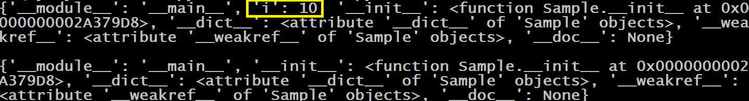
Guess The Output ?
class Sample:
i=10
def __init__(self):
del Sample.i
print(Sample.__dict__)
s1=Sample()
print()
print(Sample.__dict__)
Output:

Slide 37
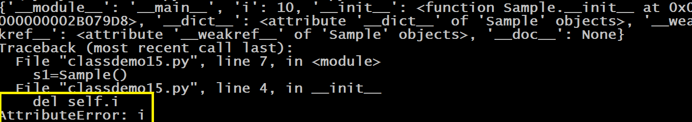
Guess The Output ?
class Sample:
i=10
def __init__(self):
del self.i
print(Sample.__dict__)
s1=Sample()
print()
print(Sample.__dict__)
Output:

Slide 38
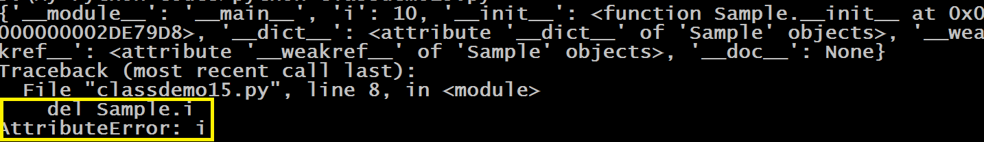
Guess The Output ?
class Sample:
i=10
def __init__(self):
del Sample.i
print(Sample.__dict__)
s1=Sample()
del Sample.i
print()
print(Sample.__dict__)
Output:

